Slide 1


Slide 2
Blind Assistant App
Submitted as Final Year Project
towards completion BS computer science
Project supervisor:
Mr. Uzair Ishtiaq

Slide 3
Team Introduction
Ahmad Raza
CUI/SP18-BCS-004/VHR
Abdul Qadir Khan
CUI/SP18-BCS-046/VHR

Slide 4
Dedication
We feel great pleasure in expressing my heartiest gratitude to my family and our honorable HOD Dr. Ali Shahid, DOO office staff and Supervisor Mr. UZAIR ISHTIAQ (Lecturer, Department of Computer Science COMSATS University Islamabad, Vehari (Campus) for kind behavior, valuable suggestions, worth and keen supervision, scholarly criticisms, sympathetic attitude towards completion of this thesis.

Slide 5
Problem Statement
Today’s technology helping people in every field of life, but visually impaired peoples are not getting benefit of technology in their life as like many people are using smartphones by seeing the feature.
But Blind people are not able to see the screen and use these features. Like if they want to make a call to someone from contact list but they are blind so they can’t do this as normal people.
If they are received a message from someone, how could they know who send this message and what is the message.

Slide 6
Proposed Solution
This is an Innovative system for blind people to get advantage of technology.
Blind Assistant App will help blind people to use smart phones by their voice
This App makes a blind people self dependent.
This system allows visually impaired to people to get connected with world easily.

Slide 7
Objective Of The System
Easy to use mobile phones for blind people
Messaging feature
Call log feature
Notes making feature
Battery status feature
Text To Speech
Speech To Text

Slide 8
Product Scope
The scope of our project is to designing a complete environment to provide a safe and user-friendly environment for blind people
The main aim of the project is to provide an easy-to-use mobile phone for blind people.
This system is for facilitate and helping the visually impaired people
We remove this hurdle and provide facilities to blind peoples and they will get benefit from technology..

Slide 9
Operating Environment
Android:
Version: 8 and above
Processor: core 2.0 and above
RAM: 2GB or more
Memory: 8 GB and more
IOS:
Version: 11 and above
Processor: core 2.0 and above

Slide 10
Development Tools
Hardwar’s :
Laptop hp core i5 6th Generation
Android smart phone
Software’s :
Flutter UI google Framework(2.5.2).
IDE Android studio.
Language :
Dart

Slide 11
Functional Requirements
Call making
SMS send and receive
Notes writing
Battery Level checking
Text to speech
Speech to Text

Slide 12
Non-Functional Requirements
Performance Requirements
App is compatible for all android mobile versions. It doesn’t take much time for any operation.it is quick responsive app.
Safety and Security Requirements
This App is completely secure app as doesn’t contain any sensitive data of user
Software Quality Attributes
Software Quality Attributes are features that facilitate the measurement of performance of a software product by Software Testing professionals, and include attributes such as availability, correctness, maintainability, useability

Slide 13
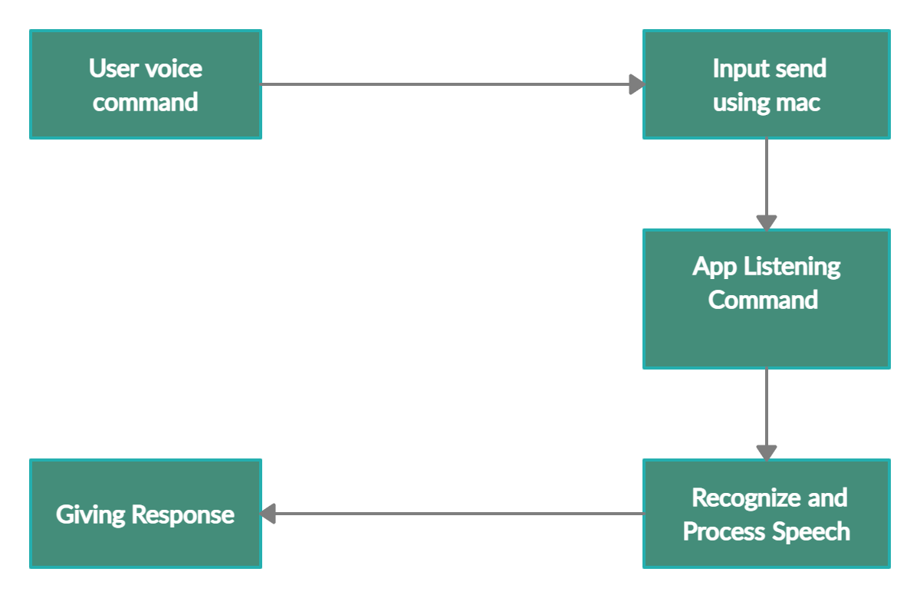
App Life Cycle

Slide 14
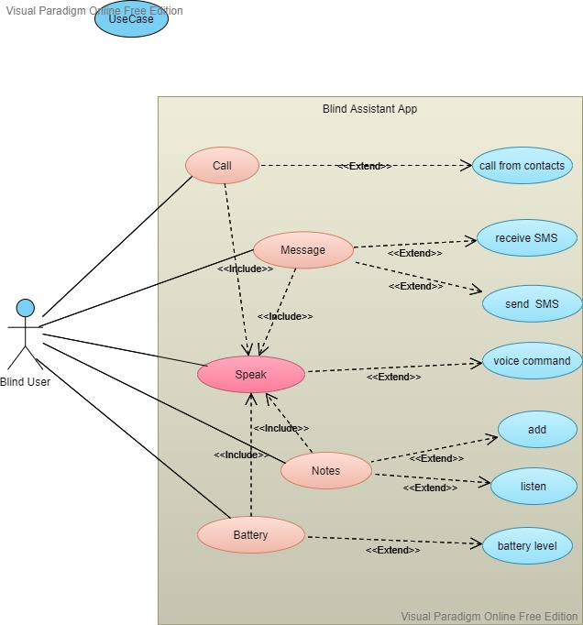
Use-Case Diagram

Slide 15
Future Plans
To Add Multiple Languages
Add More Apps Functionality like Email, Alarm etc.

Slide 16


